Slide 1
Title and Total Compensation Project Updates
Presented by: Choutae Yang

Slide 2
Overview of Session
Brief Overview of TTC
Current Timeline of TTC Project
Key Highlights of Timeline
Upcoming Forums for TTC
Questions

Slide 3
Overview of TTC
TTC stands for Title and Total Compensation
Goals:
Clear, consistent and relevant job titles and descriptions
Market-based pay and benefits structures (total compensation)
Provide a clearer framework for career development

Slide 4
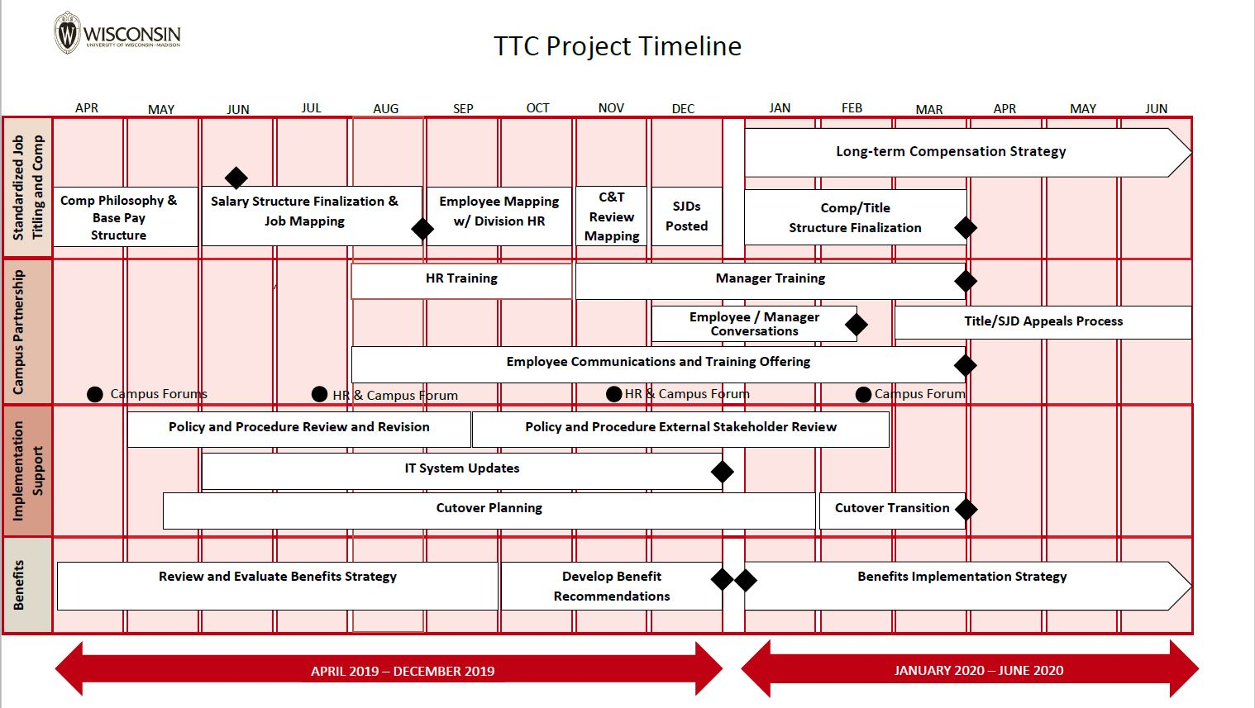
Current Timeline of TTC Project

Slide 5
Key Highlights: Timeline
September and October 2019:
  Waisman HR is mapping (also known as matching) each employee under the review of the Project (primarily Academic Staff and University Staff positions) to a job title in the new Standard Job Framework
  This is done via a comparison of the current job duties and scope of position
November 2019:
  Waisman and all other departments mapping of titles will be reviewed by a centralized HR team at UW-Madison to ensure alignment across campus
  (Tentative) Initial training will be provided to managers/supervisors in preparation for the PD review with employees
December 2019:
  Anticipated that the finalized positions for employees will be provided back to Waisman HR to share with supervisors
  Anticipated that managers/supervisors will initiate conversations with their staff to discuss the employee’s new job title and position

Slide 6
Key Highlights: Timeline cntd.
New Title/Job Structure: March 1, 2020 (tentative)
Updated Policies and Procedures: March 1, 2020 (tentative)
Updated Salary Ranges: March 1, 2020 (tentative)

Slide 7
Takeaways
Employees will not have their pay reduced
Employees will not have to re-apply for their job
Employees will not lose their job as a result of TTC
Positions are mapped not the individual performing the duties
No immediate pay increases are expected as a result of the TTC project
A long-term compensation strategy will be developed to address any pay inequities

Slide 8
Upcoming Forums: Tentative Dates
Tentative Dates | Location | Event Time
11/12/2019 | Union South (English Only) | 9:00 am – 10:30 am
11/12/2019 | Gordon Dining & Event Center (Multi-lingual) | 1:00 pm – 2:30 pm
11/13/2019 | Health Science Learning Center (Multi-lingual) – Late Night | 11:00 pm – 12:30 am
11/14/2019 | Health Science Learning Center – English Only | 11:00 am – 12:30 pm
* It is expected that dates will be confirmed soon and additional information will be shared when it becomes available

Slide 9
Helpful Links
TTC Project Website: https://hr.wisc.edu/title-and-total-compensation-study/
Video of Past Forum (July): https://hr.wisc.edu/title-and-total-compensation-study/2019/08/08/pulse_survey_1/

Slide 10
Questions?

